Slide 1

Life Expectancy & Oxidative Stress on Age
Simran Gaglani

Slide 2

Introduction
- Life expectancy is a crucial indicator of both an individual's and a population's overall health. Studies demonstrate a consistent increase in age due to both global and medical advancements.
- However, in some countries with limited medical resources and income per capita, life expectancies remain low, as they are more vulnerable against disease.
- One potential explanation for this is the accumulation of oxidative stress on cellular components such as proteins, lipids, and DNA as people age.
- At a molecular level, oxidative stress can impair an individual's ability to combat cell death - a process commonly associated with aging - underscoring the need for ongoing research efforts to identify the factors that impact age and life expectancy.

Slide 3
Goals
Global:
Explore the behavior of Life Expectancy and how it has changed over time by country
Compare Life Expectancy and Age between Developing and Developed countries.
Identify global variables that impact Life Expectancy; linear regression
Molecular:
Define and analyze the Oxidative theory
Illustrate the mathematical model of Oxidative Stress
Observe what molecular variables impact aging and cell degeneration the most
Exemplify elements of Oxidative Stress impacting metabolic pathways through data

Slide 4
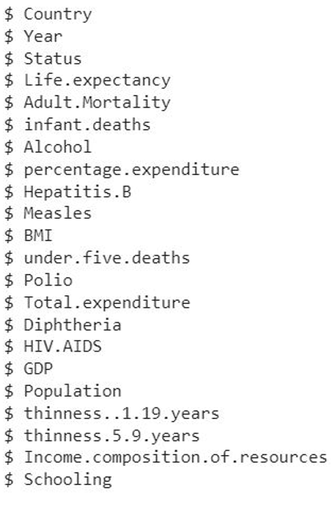
Country Data
Measles (Ratio): Number of reported Measles cases per 1000
Polio (Ratio): Number of 1 year olds with Polio immunization
Diphtheria (Ratio): immunization rate of 1 year olds for Diphtheria
Hiv (Ratio): Deaths per 1000 live births by HIV for people under 5
GDP (Ratio): Gross Domestic Product per capita
Population (Ratio): Population
Income.composition.of.resources (Ratio): Income composition of resources
Schooling (Ratio): Average number of years of schooling
Year (Ordinal): Calendar year
Country (Nominal): Country
Status (Nominal): 'Developing' or 'Developed’
Life.expectancy (Ratio): Life expectancy in years
Adult.mortality (Ratio): Adult mortality rate per 1000
Infant.deaths (Ratio): Number of infant deaths per 1000
Alcohol (Ratio): Alcohol consumption rate
Hepatitis.b (Ratio): 1 year olds with Hepatitis B immunizationmeasles

Slide 5
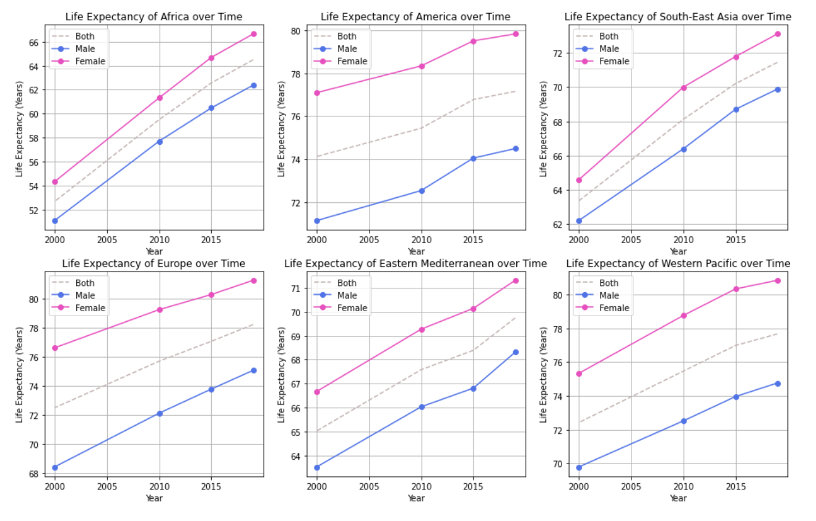
Change in Life Expectancy

Slide 6
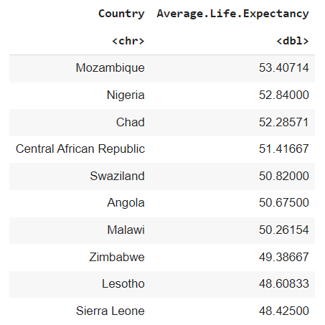
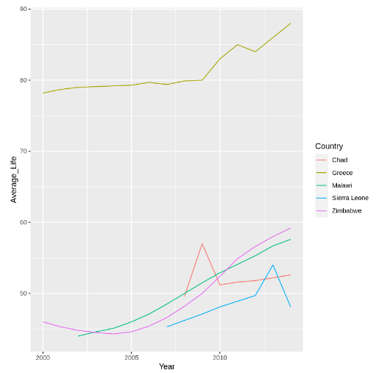
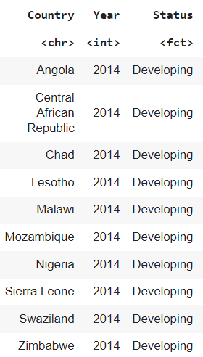
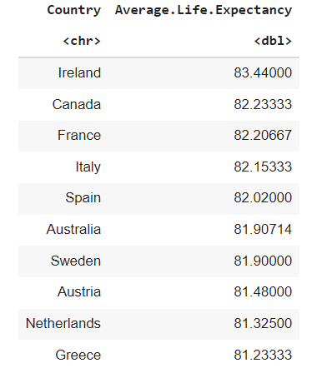
Highest vs Lowest Life Expectancy

Slide 7
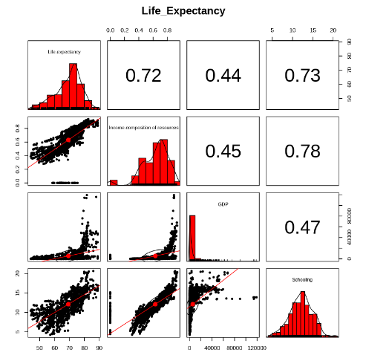
Variables Impacting Life Expectancy

Slide 8
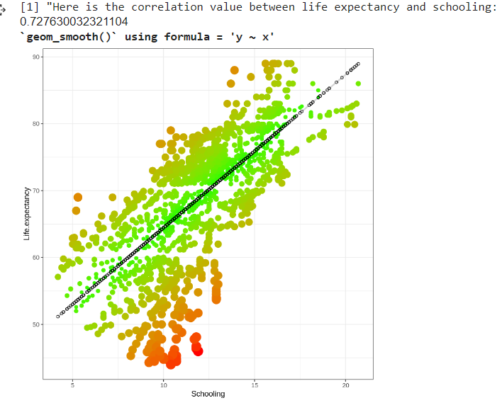
Schooling and Life Expectancy

Slide 9
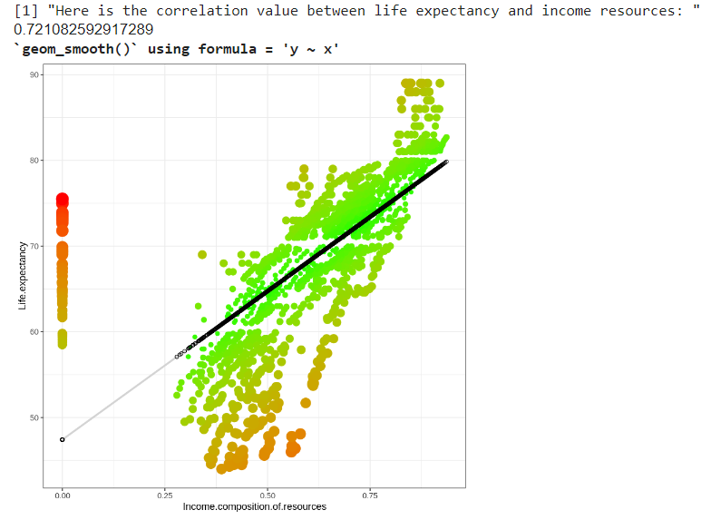
Life Expectancy and Income Composition
.721

Slide 10
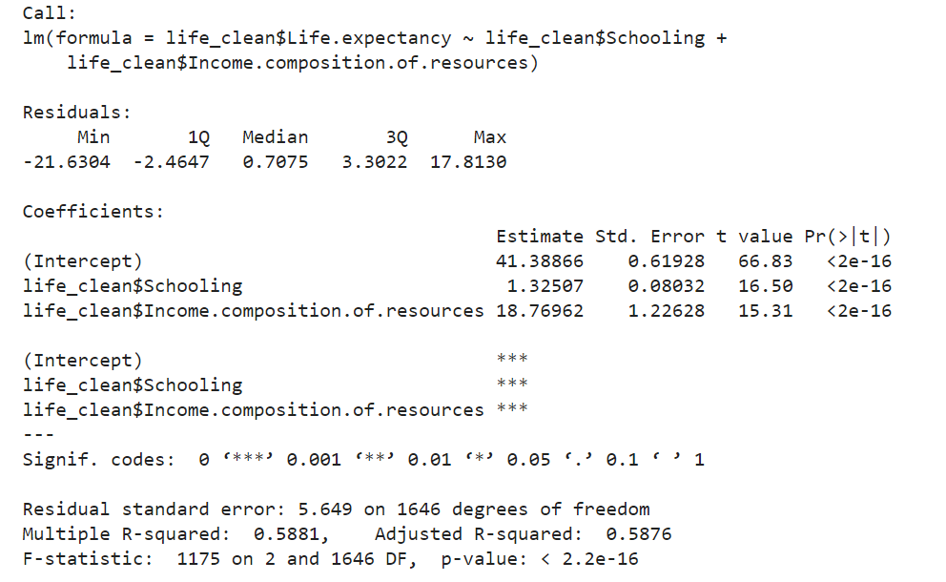
Linear Regression
The intercept term of the regression equation = 41.39, so when schooling and income composition of resources = 0, the expected life expectancy is 41.39.
The coefficient for schooling = 1.33, for every one unit increase in schooling, the expected life expectancy increases by 1.33 years, holding income composition of resources constant.
The coefficient for income composition of resources = 18.77, which means that for every 1 unit increase in income composition of resources, the expected life expectancy increases by 18.77 years, holding schooling constant.
The p-values for both coefficients are less than 0.05, indicating that they are statistically significant predictors of life expectancy.
The adjusted R-squared value is 0.5876, so 58.76% of the variation in life expectancy can be explained by the linear combination of schooling and income composition of resources.
Schooling and income composition of resources are important predictors of life expectancy. People with higher levels of schooling and greater income composition of resources tend to have longer life expectancies.

Slide 11
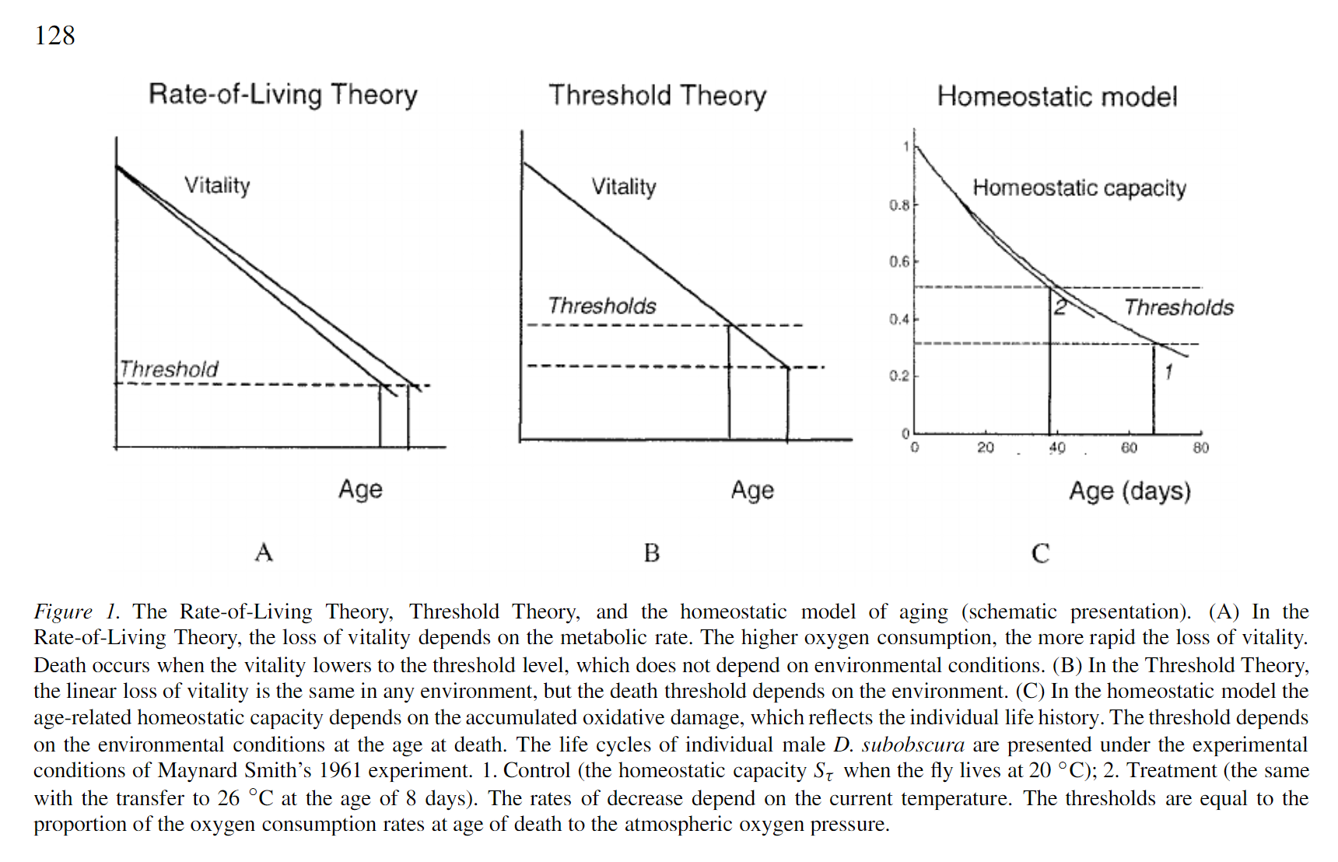
Rate of Living
The duration of life of an organism is dependent upon the exhaustion of a fixed quantity of a vital substance at a rate proportional to the metabolic rate.
The rate of living theory of aging states that people (and other living organisms) have a finite number of breaths, heartbeats, or other measures, and that they will die once they've used those up.
In the homeostatic model the age-related homeostatic capacity depends on the accumulated oxidative damage which reflects the individual life history.

Slide 12
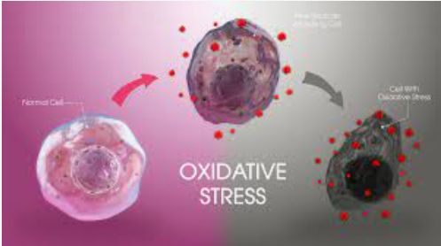
Oxidative Stress
When there is an excess of free radicals due to factors such as biological factors or even environmental toxins the body may not be able to produce enough antioxidants to neutralize them.
This can lead to a state of oxidative stress or damage, where the free radicals cause damage to cellular components, leading to cell degeneration, cellular dysfunction, and an impacted ability to create DNA, protein, or lipid.
Oxidative stress has been implicated in many health conditions, including cardiovascular disease, cancer, neurodegenerative diseases, and aging. Therefore, maintaining a balance between free radicals and antioxidants is essential for optimal health and longevity.
Aging is modeled as the progressive destruction of functional elements in the cells of the organism caused by oxidative stress, which diminishes its homeostatic capacity (and increases the risk of death).
Free radicals damage the homeostatic mechanisms of an organism so that “the accumulation of changes in the cells and tissues that increase the risk of death
The rate of production of free radicals is taken to be proportional to the rate of oxygen consumption modiﬁed by the enzymatic defense

Slide 13
Oxidative Stress Theory of Aging
The next question is where do these free radicals actually come from and the primary source of free radicals is generally thought to be the mitochondria so in fact about 90% of the free radicals that we see come from the from the mitochondria
A result of the process called oxidative phosphorylation which helps to generate ATP and energy source for the cell so this is a primary function of the mitochondria and so as they're moving electrons down along the electron transport chain which is present in the inner membrane of the mitochondria some of these electrons can leak and react with oxygen and cause the formation of free radicals.
About 1 to 4% of all the oxygen that's coming into the mitochondria going into oxidative phosphorylation to generate ATP about somewhere between 1 to 4% of this oxygen can be converted to reactive oxygen species - these estimates have changed over the year over the years.

Slide 14
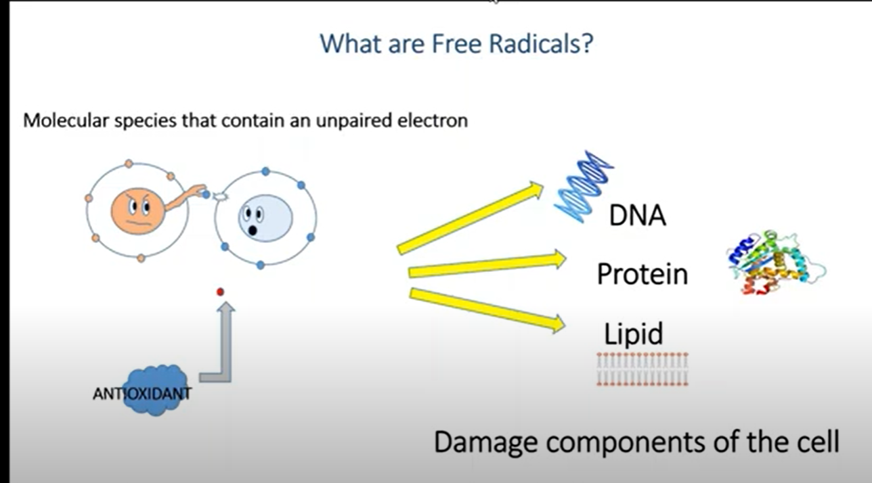
Free Radical Theory
A free radical is a highly reactive and unstable molecule that has one or more unpaired electrons in its outermost shell.
These unpaired electrons make the molecule extremely reactive, as it seeks to pair up with other electrons to become more stable.
Free radicals are one of the primary causes of oxidative stress. Oxidative stress occurs when there is an imbalance between free radicals and antioxidants in the body.
When there are too many free radicals and not enough antioxidants to neutralize them, oxidative stress can occur. The excess free radicals can then damage cellular components such as DNA, proteins, and lipids, leading to inflammation, cellular dysfunction, and ultimately, disease.

Slide 15
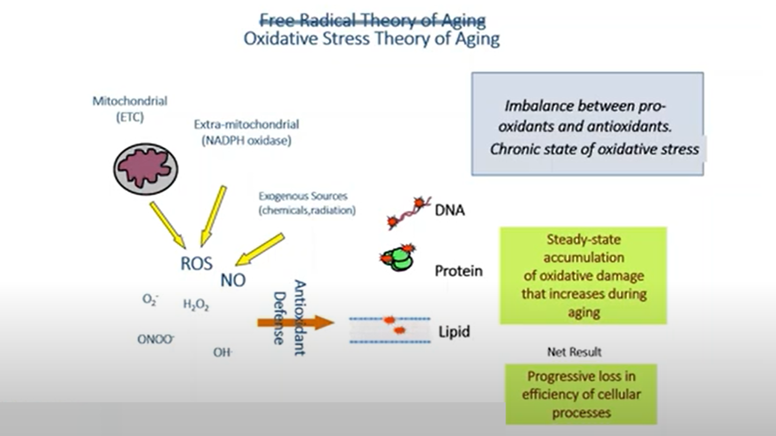

Slide 16



Oxidative Stress Equation
A mathematical model to explain the aging process:
Equation (1) is a differential equation that describes the rate of change of the homeostatic capacity of an organism with respect to age (τ). Specifically, it describes how the homeostatic capacity (Sτ) changes over time due to oxidative stress, which is proportional to the rate of oxygen consumption (Wτ) in the organism. The equation is:
dSτ/dτ = -βτ * Wτ * Sτ
Where βτ is a coefficient that characterizes the oxidative vulnerability of the cells at age τ, and the negative sign indicates that the homeostatic capacity decreases over time due to oxidative stress. Equation (2) gives the solution to the differential equation (1) and describes how the homeostatic capacity (Sτ) changes with respect to age (τ). The equation is:
Sτ = S0 * exp[-∫(0,τ) βτ * Rτ dτ]
Where S0 is the initial homeostatic capacity of the organism at birth (i.e., Sτ = S0 when τ = 0), and the integral represents the cumulative effect of oxidative stress on the homeostatic capacity over the lifetime of the organism. Equation (3) is used to calculate the rate of aging (Rτ) at a particular age (τ). The equation is:
Rτ = βτ * Wτ

Slide 17
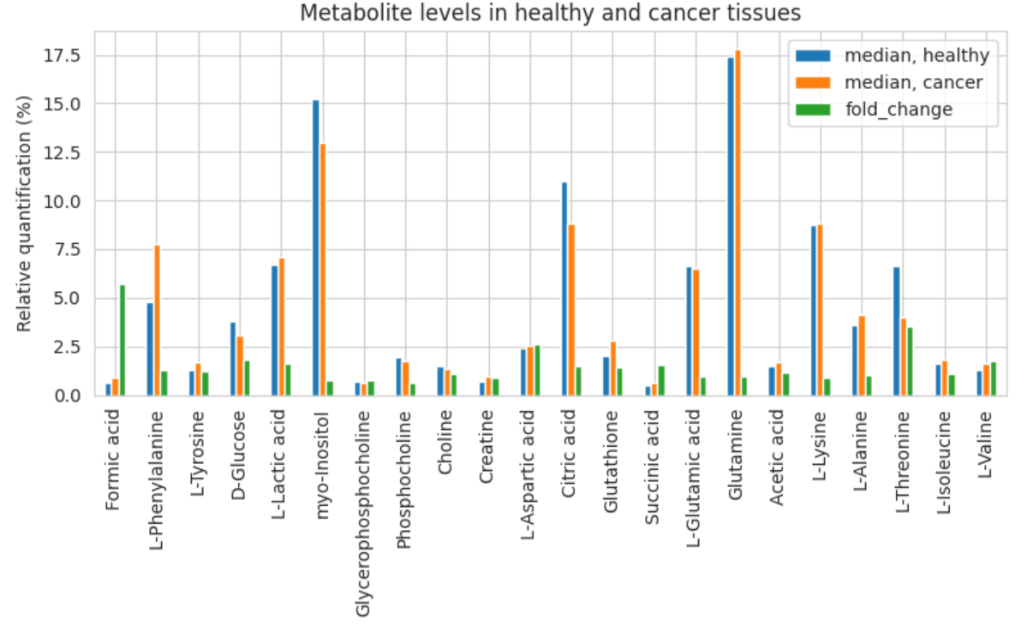
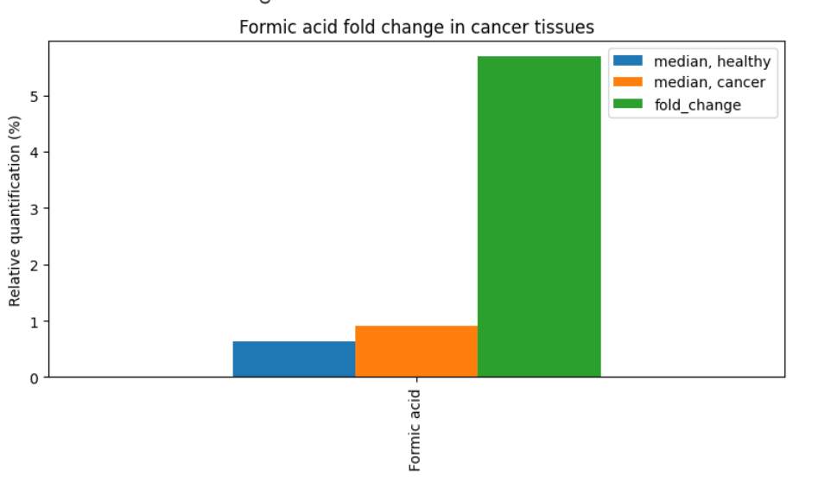
Fold Change & Oxidative Stress
Fold Change: Dataset – Since Formic acid has the biggest fold change and it is quite large, it means that the level of Formic acid is significantly different between cancer and healthy tissues.
>> If the fold change = > 1: the level of Formic acid is higher in cancer tissues compared to healthy tissues.
>> if the fold change = < 1: the level of Formic acid is lower in cancer tissues compared to healthy tissues.
>> A fold change = 1: there is no difference in the level of Formic acid between the two tissue types.
Formic acid stress can induce oxidative stress, inhibit cell creation, and cause cell degeneration.
A large fold change for Formic acid suggests that it may be a potential biomarker for cancer, and further investigation is needed.
In the context of analyzing fold change of metabolites between healthy and cancerous tissue, fold change can be an indicator of the impact of oxidative stress on cellular metabolism, which impacts age.
Changes in metabolic pathways can reflect the cellular response to oxidative stress, thus impacting life expectancy.
So, if the fold change of a metabolite between cancerous tissue and healthy tissue is significant, it could suggest that oxidative damage may have impacted the cell’s ability to influence that metabolite.

Slide 18
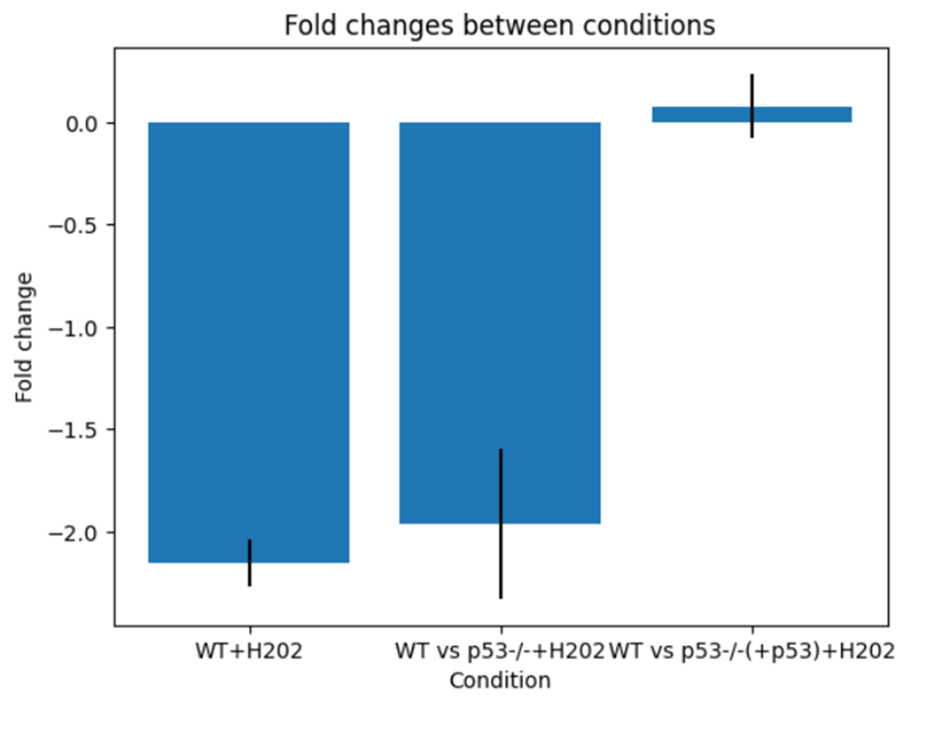
The Dataset: Gene Expression
This study shows the effect of the tumor suppressor protein p53 on the response to oxidative stress in mouse embryonic fibroblasts. When cells are exposed to stress or damage, such as DNA damage or oxidative stress, p53 is activated and triggers a series of responses, including cell cycle arrest and DNA repair.
Calculates the fold change and p-value for each gene between the control and treatment conditions for the three experimental groups:
'WT+H202': This is the control condition, where no changes have been made to the experimental setup.
'WT vs p53-/-+H202': This condition compares wild-type (WT) cells to p53 knockout (-/-) cells that have been treated with H202 (a chemical compound used in the experiment).
'WT vs p53-/-(+p53)+H202': This condition compares WT cells to p53 knockout cells that have been genetically engineered to express p53 again, and have been treated with H202.

Slide 19
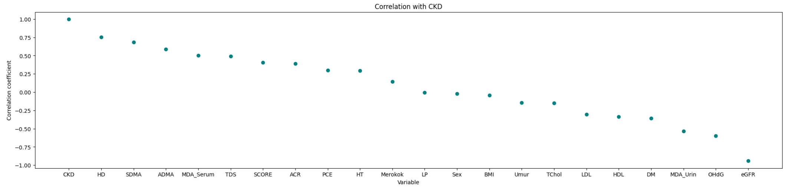
Correlation Coefficient
“Hydrogen Deuterated (HD) nucleosides and proteins protect from oxidative damage. Dietary intake of hydrogen deuterium oxide decreases cochlear metabolism and oxidative stress”
ScienceDirect: “https://www.sciencedirect.com/science/article/pii/S2213231722002440”

Slide 20
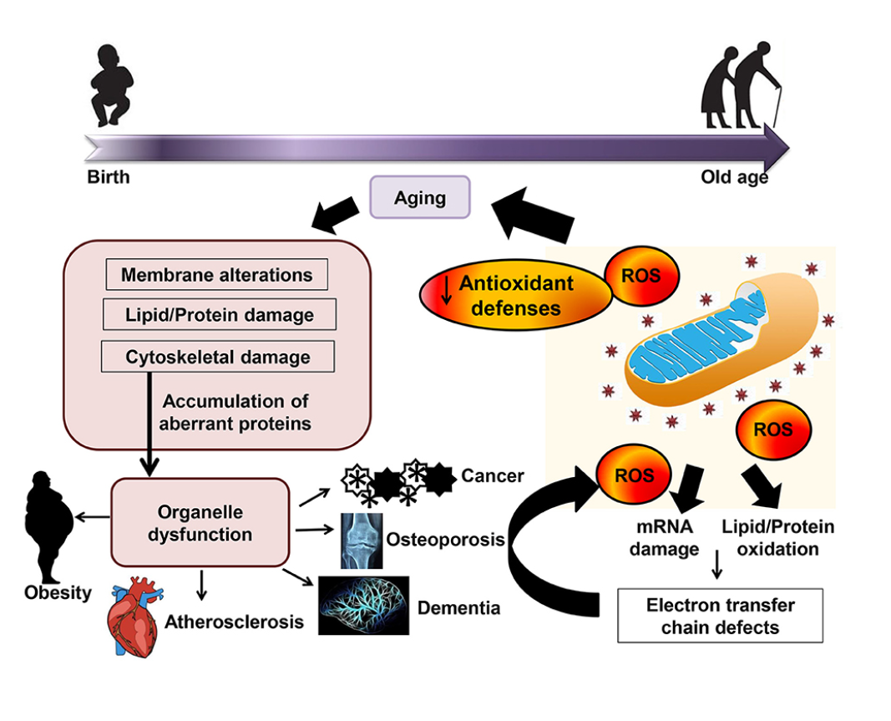
Conclusion

Slide 21
REFRENCES
https://www.ncbi.nlm.nih.gov/pmc/articles/PMC7263278/#SM1
https://www.ncbi.nlm.nih.gov/pmc/articles/PMC7345942/
https://f1000research.s3.amazonaws.com/manuscripts/78792/2f35c9ac-8df7-45f2-98da-8ceb97c9ea19_74985_-_mochammad_thaha.pdf?doi=10.12688/f1000research.74985.1&numberOfBrowsableCollections=94&numberOfBrowsableInstitutionalCollections=4&numberOfBrowsableGateways=51
https://www.ncbi.nlm.nih.gov/pmc/articles/PMC5927356/

